Slide 1
Medical Question Topic Modeling
By- Jessica Gunther,
Bhavesh Ahluwalia ,
Shreya Shrestha and
Chris Balingcongan

Slide 2
Why analyze medical questions?
Can find relevant and useful information
Medical vocabulary can be analyzed
Can ease the labor of healthcare professionals that must read each question
Can result in great support for both patients and health care professionals in terms of improvement in the quality of care services, reduction in the number of medical errors, prevention and detection of diseases, treatment identification, etc.

Slide 3
TABLE OF CONTENTS
01
02
03
04
Preprocessing
K-means Clustering
Understanding the text; prepare for modeling
With and without word embeddings
LDA Topic Modeling
Discussion
Topic discovery and question tagging
Learnings and limitations of our work

Slide 4
01
Preprocessing

Slide 5

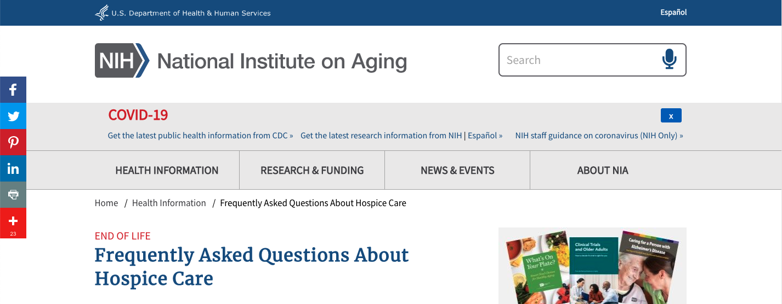
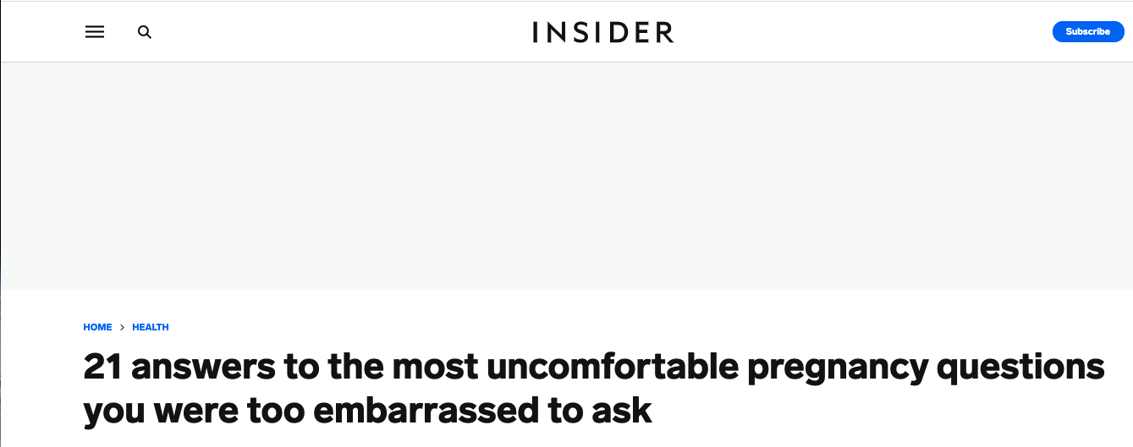
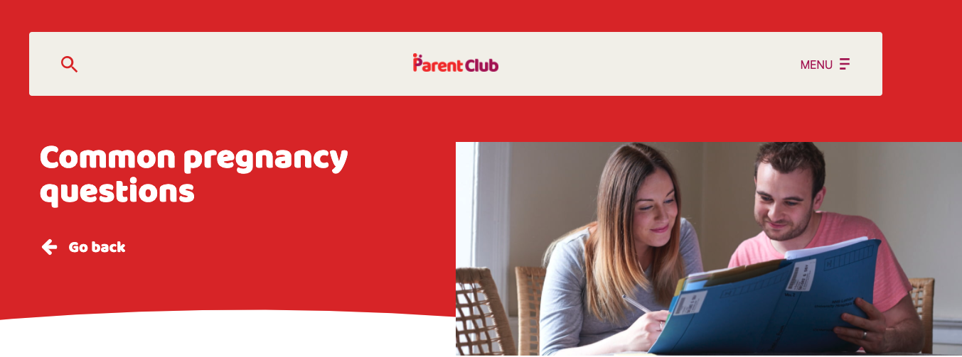
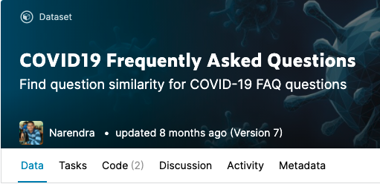
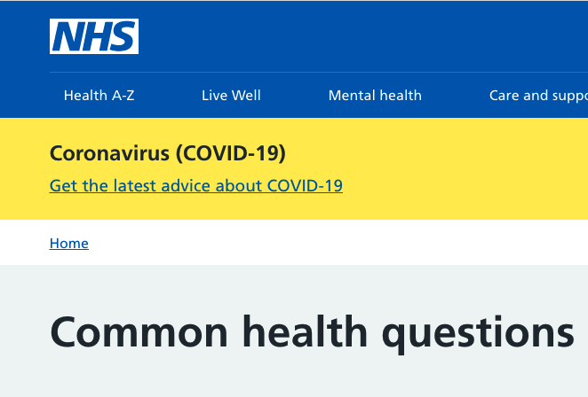

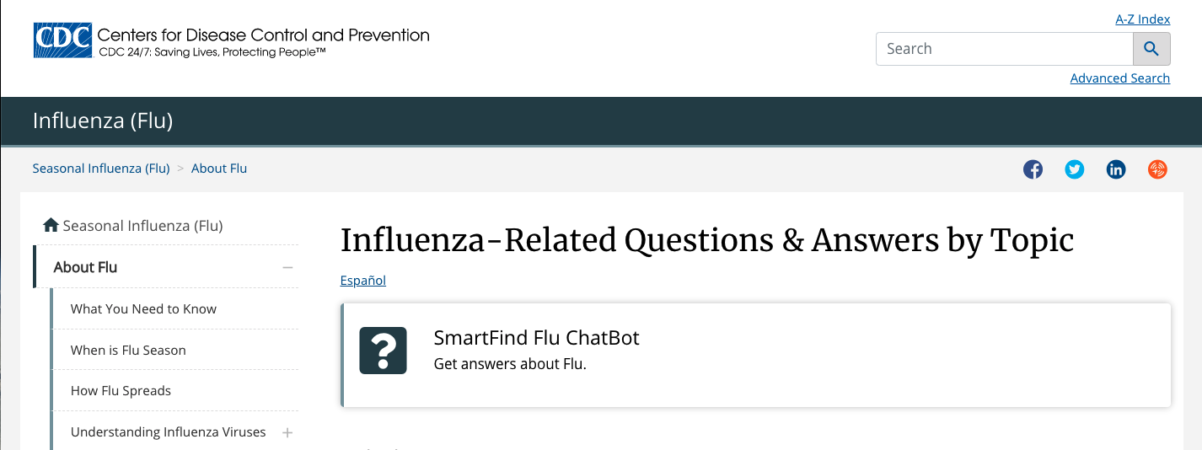
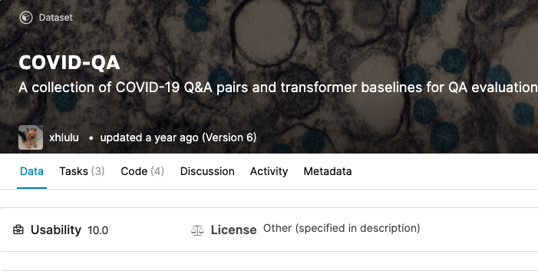
Medical_Qs_Shreya.ipynb
Medical_Qs_Jessica.ipynb
Medical_Qs_Bhavesh.ipynb
Medical_Qs_Chris.ipynb

Slide 6
Combining Medical Data
We each worked on data sourcing and cleaning separately and worked together on the preprocessing and presentation
Medical_Qs_Bhavesh.ipynb
Medical_Qs_Chris.ipynb
‘Questions_Concat.ipynb’
Notebook which concatenates all of our different questions into one dataframe and exports as a CSV
‘CombinedMedicalQuestions.csv’
Output of ‘Questions_Concat.ipynb’
Medical_Qs_Jessica.ipynb
Medical_Qs_Shreya.ipynb

Slide 7
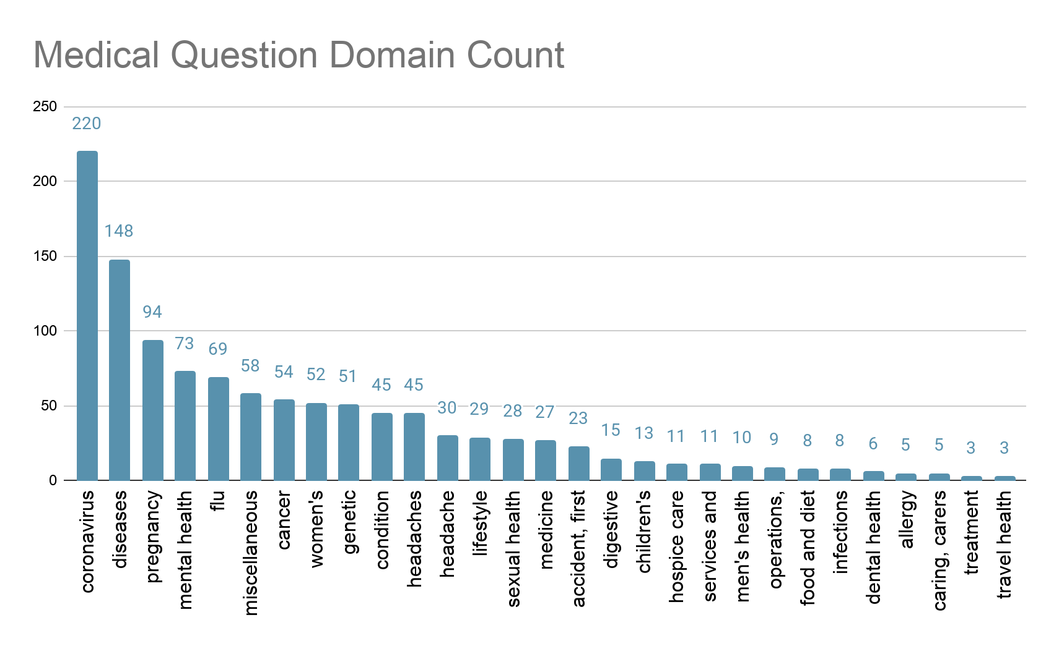
METADATA

Slide 8
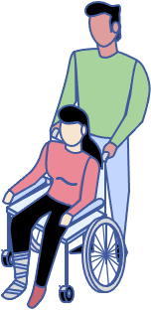
Total Medical Questions
1153

Slide 9



DATA CLEANING + Inspection
STOP-WORDING
LEMMATIZATION
COLLOCATIONS
1
2
3
4
5
6
7
TOKENIZATION
Finding Important Words
N-GRams
REMOVAL OF PUNCTUATIONS

Slide 10
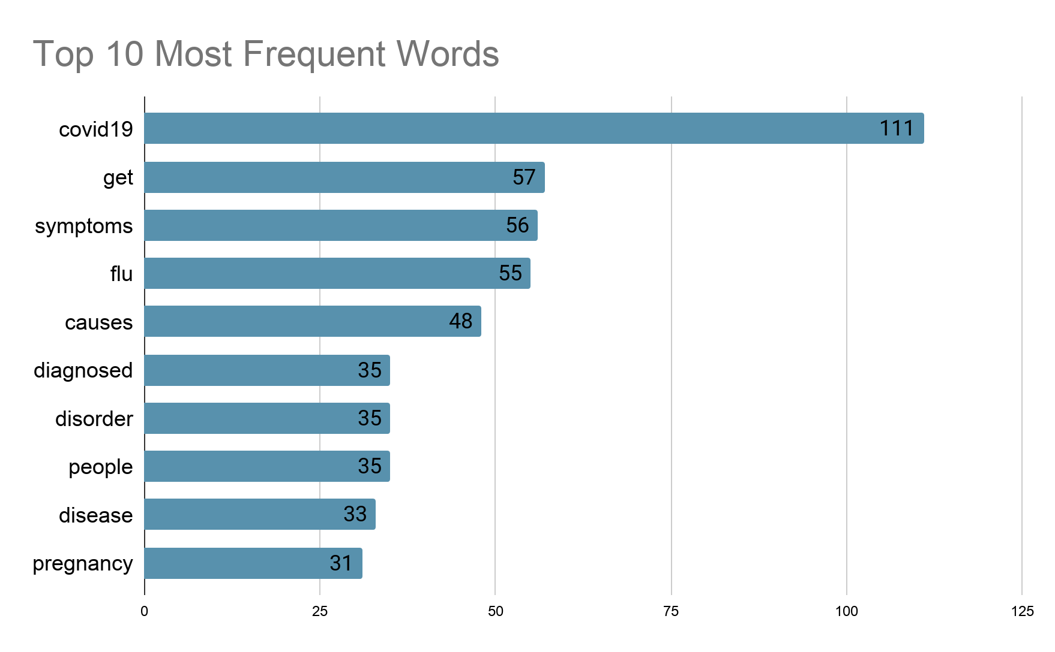
FInding important words

Slide 11
Collocations
kidney stone; brain tumor; healthcar provid; femal infertil; alcohol
intoler; flu vaccin; anal cancer; alopecia areata; alcohol
cardiomyopathi; vitamin defici; substanc use; question ask; genet
mutat; optic nerv; outlook peopl; abnorm menstruat; influenza flu;
autism spectrum; eat disord; side effect

Slide 12
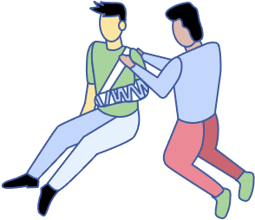
N-grams
Frequent 2 Grams
('optic', 'nerv'), ('alopecia', 'areata'), ('abnorm', 'menstruat'), ('give', 'birth'), ('question', 'ask'), ('prognosi', 'outlook'), ('femal', 'infertil'), ('brain', 'tumor'), ('menstruat', 'period'), ('healthcar', 'provid'), ('kidney', 'stone'), ('vitamin', 'defici'), ('ask', 'doctor'), ('side', 'effect'), ('genet', 'mutat'), ('someon', 'els'), ('autism', 'spectrum'), ('anal', 'cancer'), ('alcohol', 'cardiomyopathi'), ('hospic', 'care')
Frequent 3 Grams
('abnorm', 'menstruat', 'period'), ('question', 'ask', 'doctor'), ('autism', 'spectrum', 'disord'), ('genet', 'mutat', 'caus'), ('substanc', 'use', 'disord'), ('viru', 'caus', 'covid19')

Slide 13
02
K- means
clustering

Slide 14
K-Means Clustering
K-means clustering algorithm is used to find groups which have not been explicitly labeled in the data
We use the Tf-IDF scores for each terms of the Medical Questions using the Tf-IDFVectorizer object implementation from the sklearn package.
We then calculate the TF-IDF weights and cluster the dataset to find hidden structures within the questions.
A fundamental step for any unsupervised algorithm is to determine the optimal number of clusters.
The Elbow Method is one of the most popular methods to determine this optimal value of k.

Slide 15
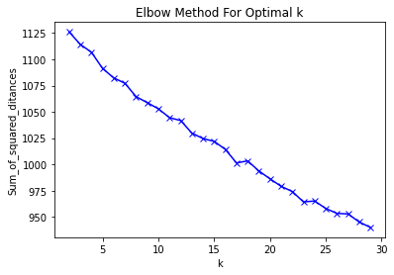
The ‘Elbow” Method
K = 16
Notes:
We generated a graph using the sum of squared error for different parameters of k
As we know that it is not as straightforward to calculate the number of clusters/topics in a text data. We can see that we don’t have a clear elbow in this graph
However we can see several points here in this graph. We select 16 as the optimal parameter of k

Slide 16
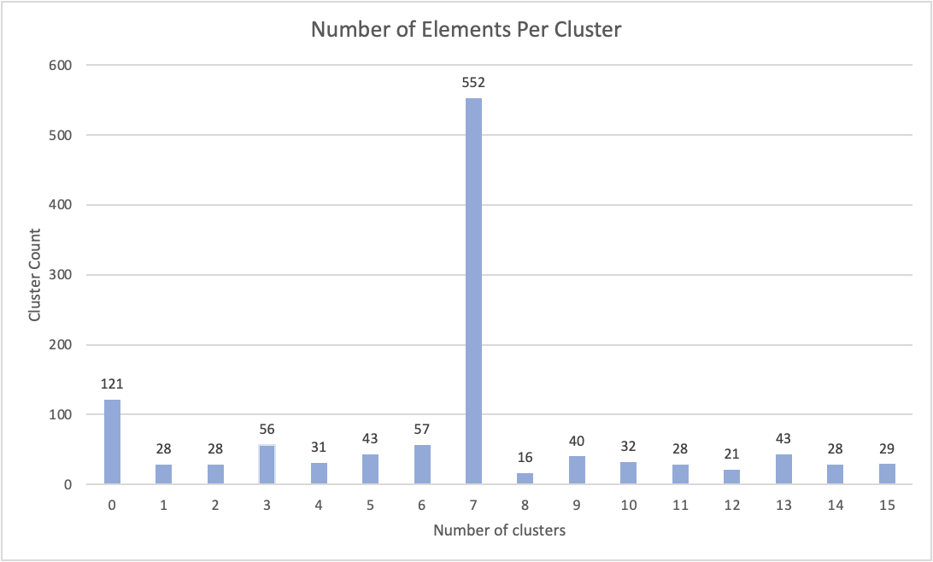
Number of elements per cluster

Slide 17
Top terms in each cluster

Slide 18
Cluster 0: covid19, coronavirus, infected, test, area, alopecia, symptoms, spread, person, virus
Cluster 1: chickenpox, child, vaccine, discharge, complications, hospital, shot, school, painkillers, adults.
Cluster 2: disorders, eat, bipolar, treatments, spectrum, autism, symptoms, prevent, genetic, diagnosed.
Cluster 3: flu, vaccine, influenza, season, swine, available, effects, shingrix, work, know
Cluster 4: used, substances, disorders, mask, dispose, needles, covid19, medications, benefits, prevent,
Cluster 5: migraine, headaches, triggers, causes, hereditary, children, cured, types, diagnosed, pain

Slide 19
Cluster 6: causes, mutate, genetic, acne, nerve, symptoms, virus, asthma, drusen, optic,
Cluster 7: treated, diagnosed, symptoms, syndrome, diseases, vitamin, common, people, thyroid, gastritis,
Cluster 8: doctor, ask, questions, healthcare, provider, infertility, females, diagnosed, prescribe, contact
Cluster 9: menopause, sex, pregnency, time, start, affect, birth, happens, ultrasound, life
Cluster 10: cancer, anal, treatments, causes, staging, symptoms, prostate, effects, patients, risk,
Cluster 11: pregnant, safe, im, dangerous, feel, shot, drink, caffeine, fly, tired

Slide 20
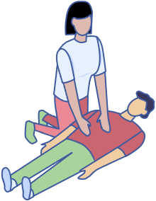
Cluster 12: kidney, stone, pass, long, help, juice, prevent, drink, developing, multiple
Cluster 13: cancer, prevent, anal, treatments, headaches, staging, diagnosed, help, marks, stretch,
Cluster 14: different, cold, types, common, cough, flu, vagina, delivery, always, symptoms
Cluster 15: alcohol, intolerant, cardiomyopathy, drink, causes, common, diagnosed, symptoms, im, intoxicated

Slide 21
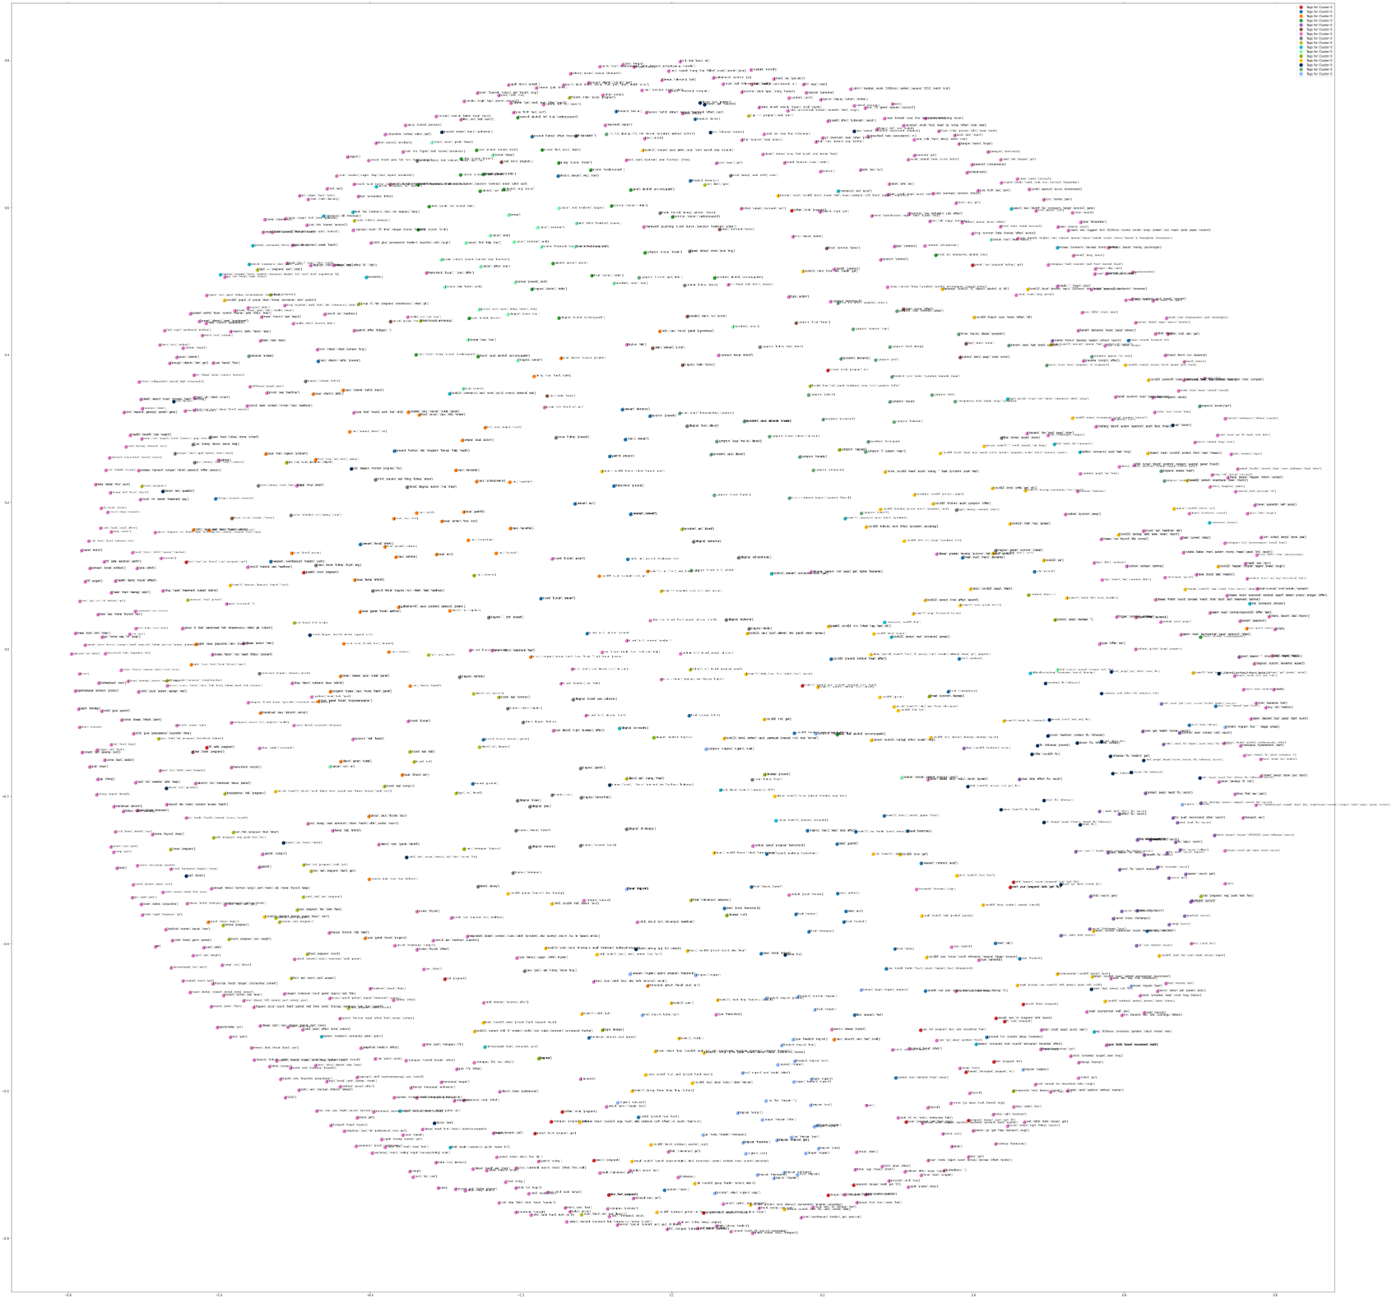
Visualizing the clusters

Slide 22
03
LDA
Topic modelling

Slide 23
LDA inputs
Text
Corpus
id2word
num_topics
cleaned questions, stop-word removal, bi-grams, lemmatization
Each word in the corpus has its own id; each word in each question has a count for how many times it occurs
keeps track of the unique ID for each word in the body of text
The number of topics you wish for your LDA model to return as output

Slide 24
LDA inputs
Lens 1:
Coherence score of the model or how similar the words of each topic are semantically
num_topics
The number of topics you wish for your LDA model to return as output
Lens 2:
Visualization of the topics in two-dimensional space, are they clearly separable?
Lens 3:
Natural number of topics or domains that we tagged from our sources

Slide 25
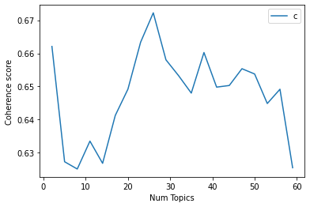
Coherence by
number of topics
K = 26
(pretty close to our original 29 domains!!)

Slide 26
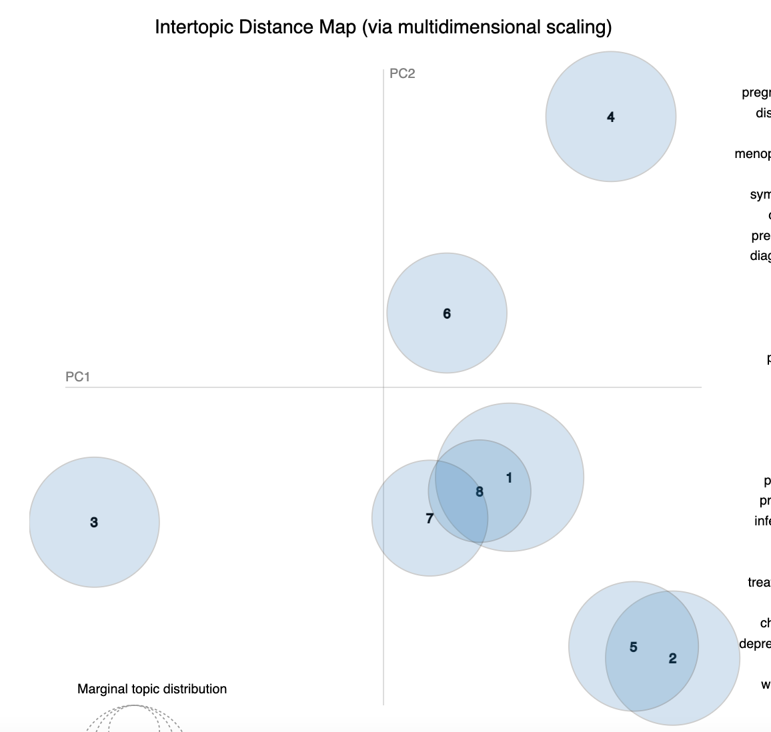
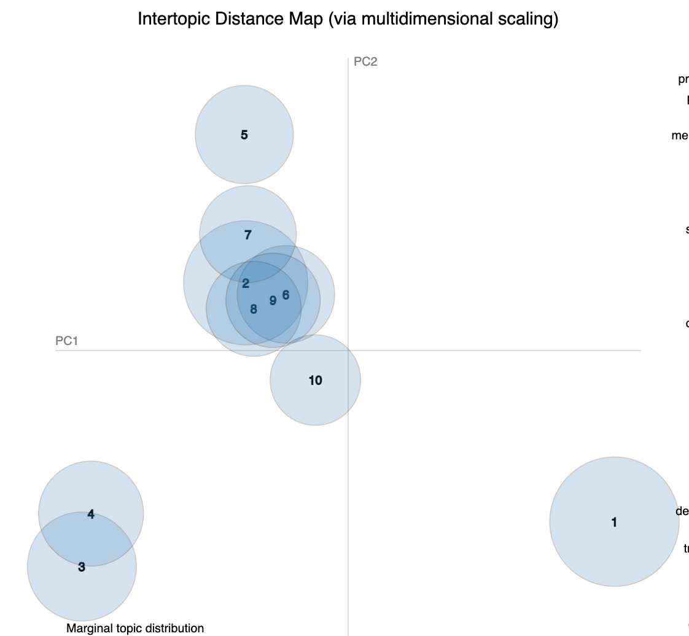
Visualizing topics
K = 8
K = 10

Slide 27
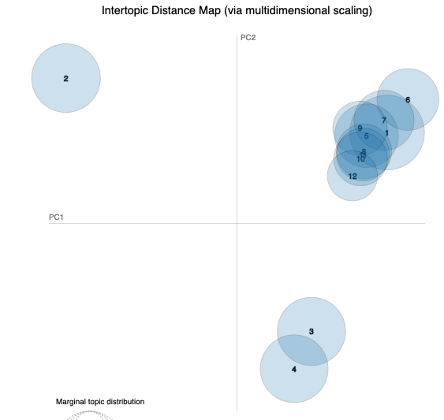
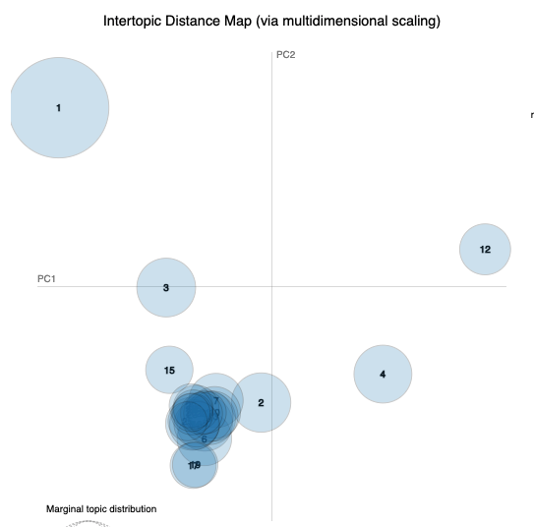
Visualizing topics
K = 13
K = 26

Slide 28
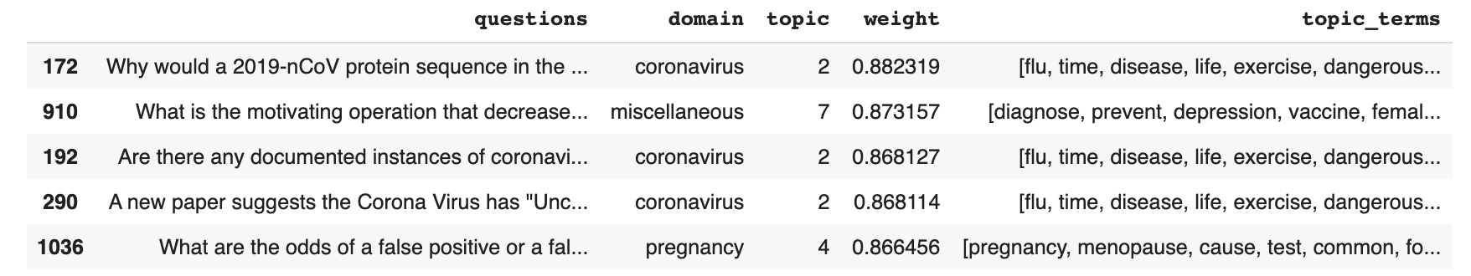
A closer look: Num_Topics=8

Slide 29
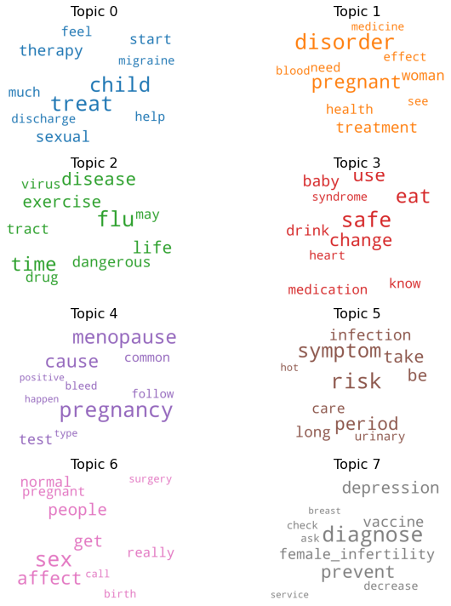
A closer look: Num_Topics=8
What is the process for evaluating the criticality of official travels and meetings?
Can I access someone else's medical records (health records)?
What are the odds of a false positive or a false negative on a pregnancy test?
How soon after becoming infected with COVID-19 will I develop symptoms?
How to get 5-year-old to consistently cover mouth when coughing?
Why would a 2019-nCoV protein sequence in the NCBI database match a protein submitted in 2018?
Can CPAP devices connected with oxygen sources be used as ventilators?
Why do so many people believe there is a link between autism and the measles, mumps, and rubella vaccine?
Notes:
The questions are the questions that are the strongest representation for each topic.

Slide 30
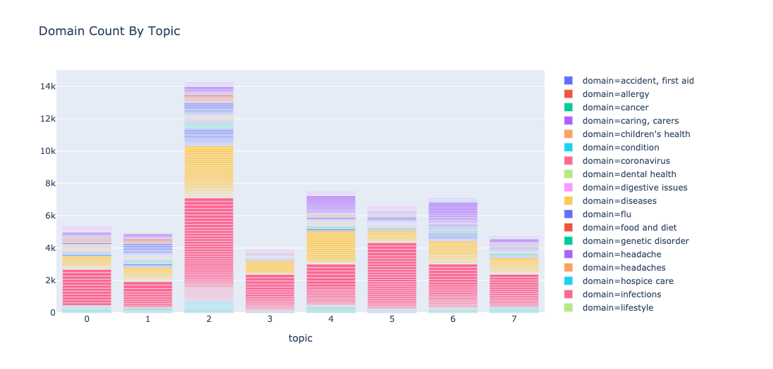
A closer look: Num_Topics=8

Slide 31
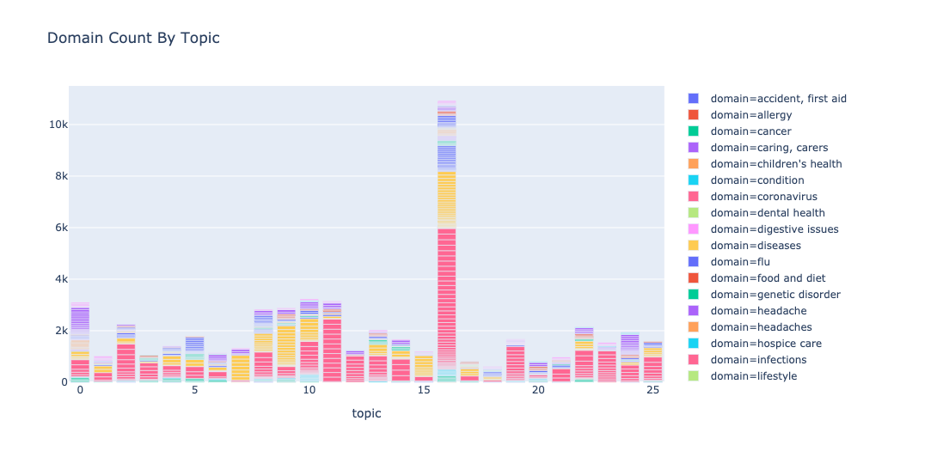
A closer look: Num_Topics=26

Slide 32
04
Discussion

Slide 33
Learnings + limitations
K-means for separating the clusters.
Cluster 7 has the highest number of terms with 552.
Topic modeling is hard!! there is not magic bullet algorithm that will surface topics how you think they should be surfaced
Domain tags can be subjective
Unequal distribution of domains (lots of covid questions)

Slide 34
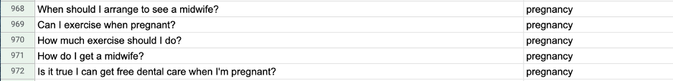
Learnings + limitations
Domain tags can be subjective
Example1:
Example2:

Slide 35
Learnings + limitations
Unequal distribution of domains

Slide 36
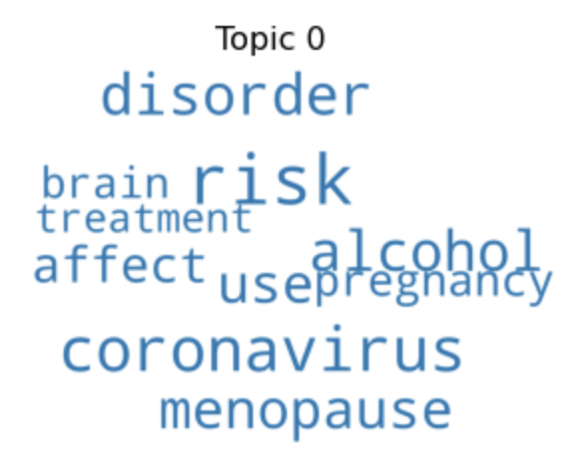
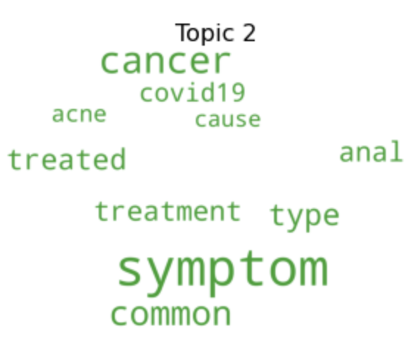
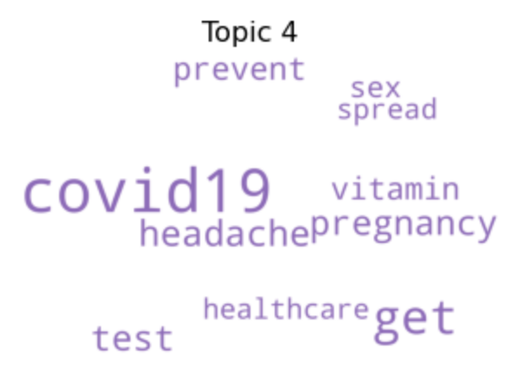
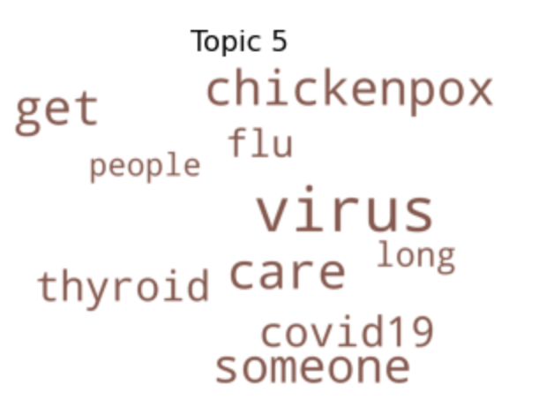
Learnings + limitations
Unequal distribution of domains (lots of covid questions)

Slide 37




OUR TEAM
Jessica
gunther
Shreya
Shrestha
Bhavesh
ahluwalia
Chris Balingcongan

Slide 38
THANKS!
Do you have any questions?

